Slide 1


SUPERMARKET
DATABASE
MANAGEMENT
SYSTEM
Prajwal - vu21csen0100317
Harshitha - vu21csen0100328
Thoshitha - vu21csen0100329
Pushkar - vu21csen0100473

Slide 2

Introduction
Efficient management of a supermarket is essential for delivering quality services to customers and optimizing business operations. The Supermarket Database Management System is a computer-based software solution designed to automate and enhance the management of various aspects within a supermarket environment. This system is tailored to improve the quality and efficiency of operations, including inventory management, sales tracking, and customer interactions.
This software assigns unique identifiers to products, employees, and other essential entities, allowing for efficient data organization and retrieval.

Slide 3

Problem
This system is manual.
The information is very difficult to retrieve, for example, to find product availability or sales history.
Manual data entry has a chance of inaccuracy.
Manual data entry is inefficient.
Wastage of time.

Slide 4
Solution
It will be the Computer-based system.
Data entry becomes more efficient.
Reduction Of errors.
No Wastage of time.

Slide 5
Data Requirement...
SUPPLIERS Table
BROUGHT FROM Table (Relates Suppliers to Products)
Product Table
Sid: Supplier ID (Primary Key)
Sname: Supplier Name
Sphone: Supplier Phone Number
Saddress: Supplier Address
Semall: Supplier Email Address
Pid: Product ID (Primary Key)
Ptype: Product Type
Pname: Product Name
Mprice: Manufacturer Price
Cprice: Customer Price
Pquant: Product Quantity in Stock
Sid: Supplier ID (Foreign key)
Sid: Supplier ID (Foreign Key)
Sname: Product ID
(Other attributes like Phone, Address, Email)

Slide 6
Data Requirement...
BUYS Table (Relates Customers to Purchases)
EMPLOYEE Table
SERVES Table (Relates Employees to Customers They Serve):
EId: Employee ID (Primary Key)
Name: Employee Name
Age: Employee Age
PhoneNumber: Employee Phone Number
Address: Employee Address
DateOfJoining:Date of Joining (Employee)
Salary: Employee Salary
Department: Employee Department
EId(Manageror SupervisorID,if applicable)
Cid: Customer ID (Foreign Key)
CName: Customer Name
CPhone: Customer Phone Number
Address: Customer Address
joinDate:Date of Joining (Customer)
CSpent:Amount Spent by Customer
EId: Employee ID (Foreign Key)
Cid: Customer ID (Foreign Key)

Slide 7
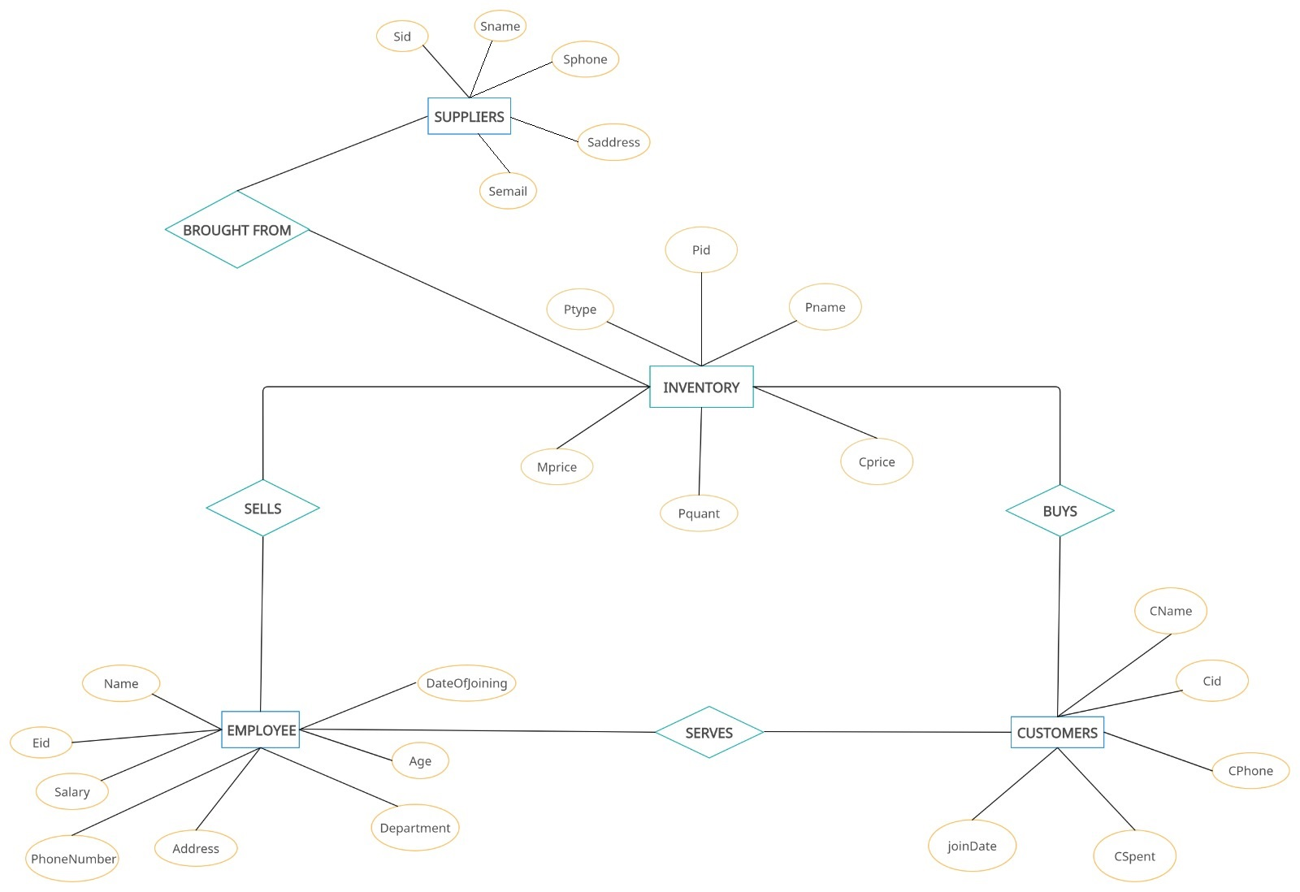
ER Diagram

Slide 8
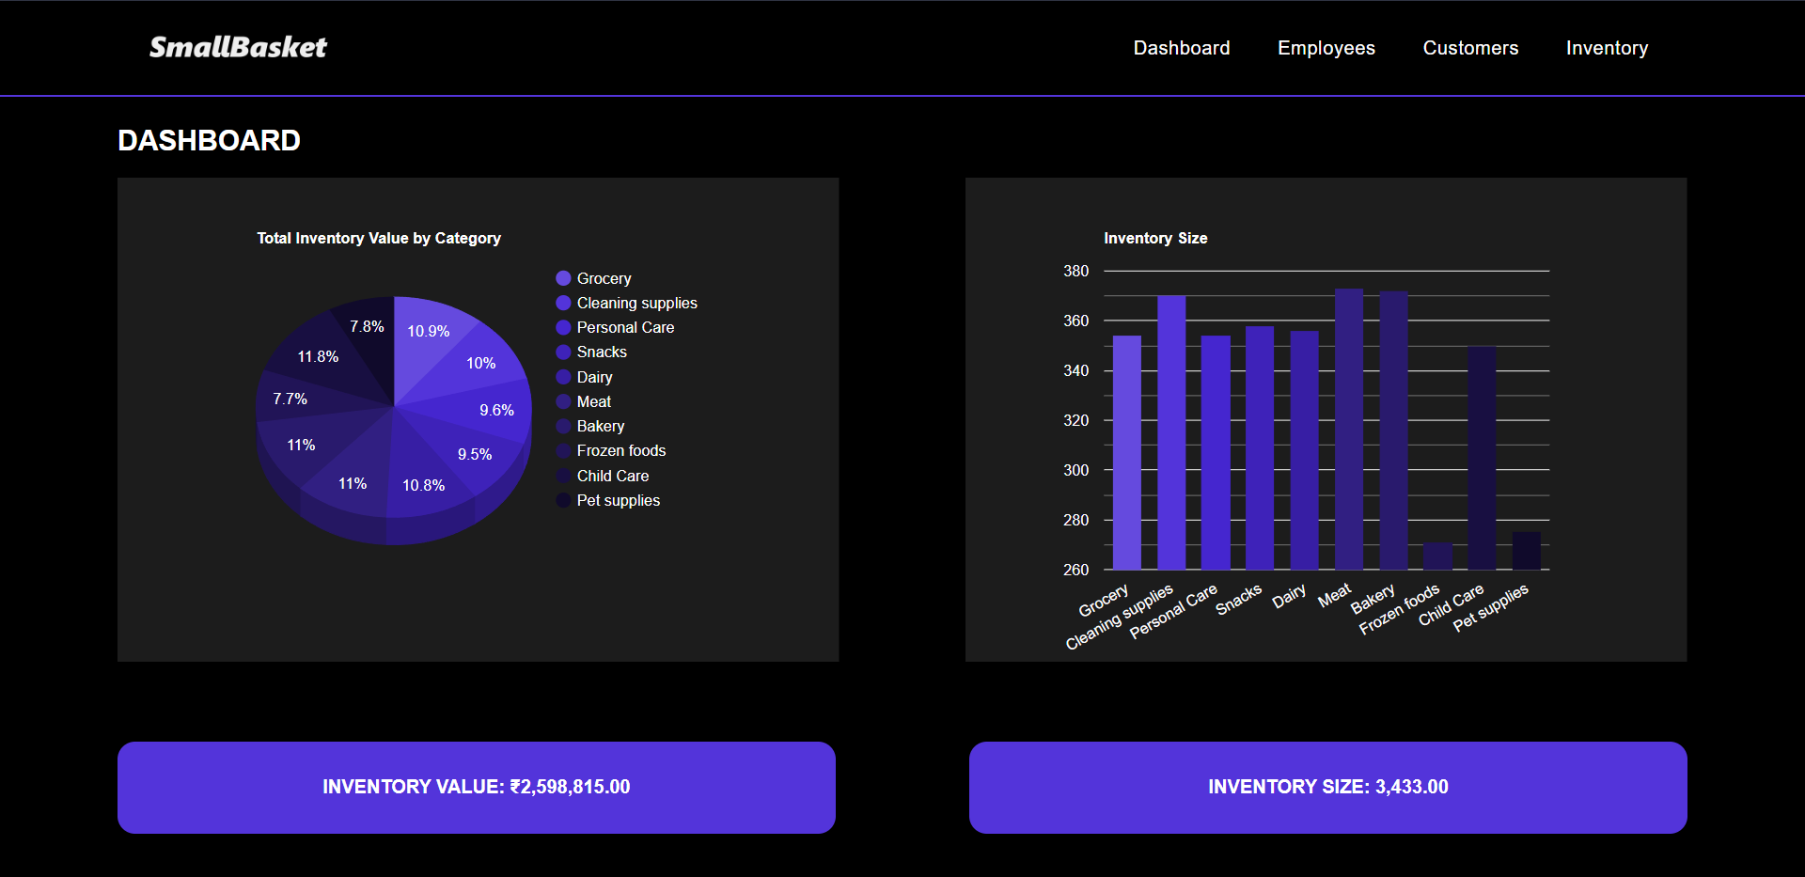
Dashboard

Slide 9
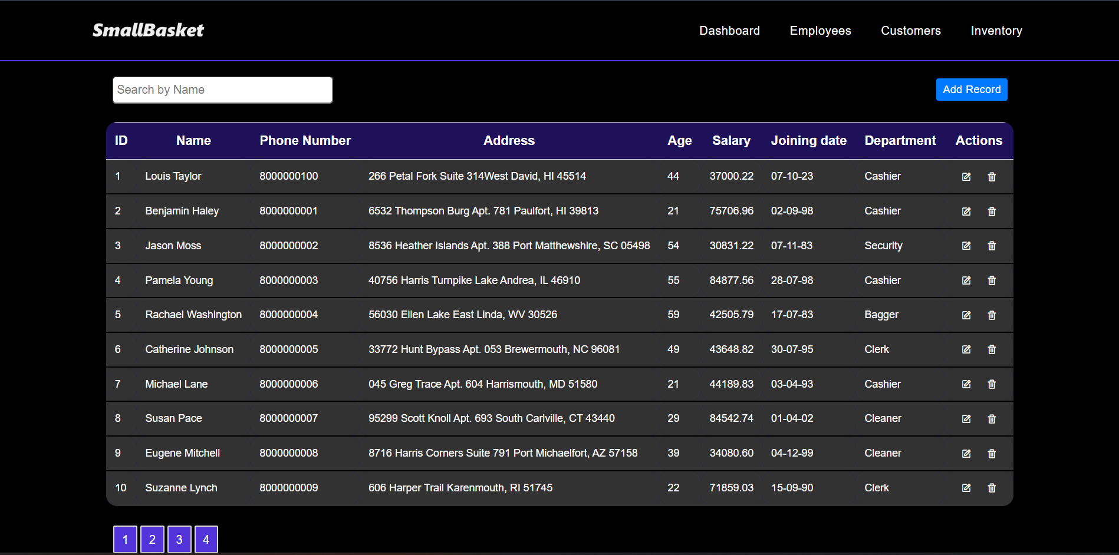
Table Display

Slide 10
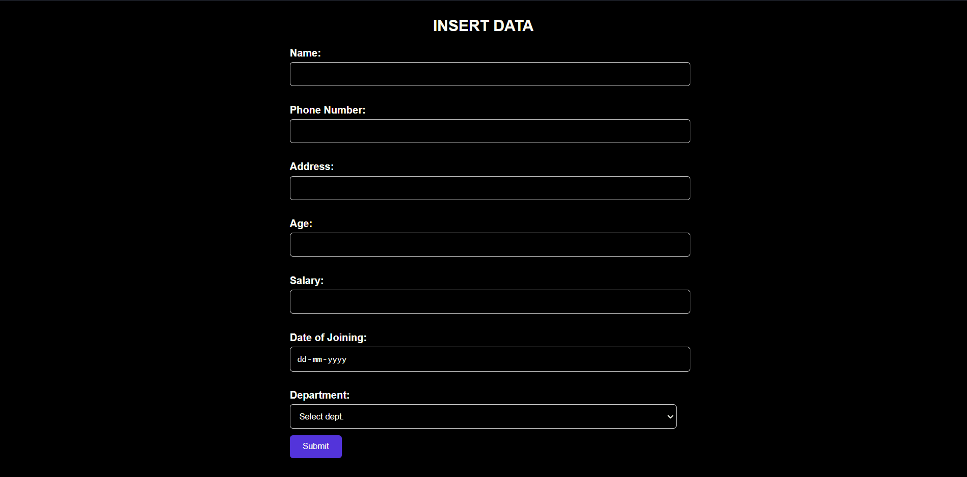
Insert new data

Slide 11
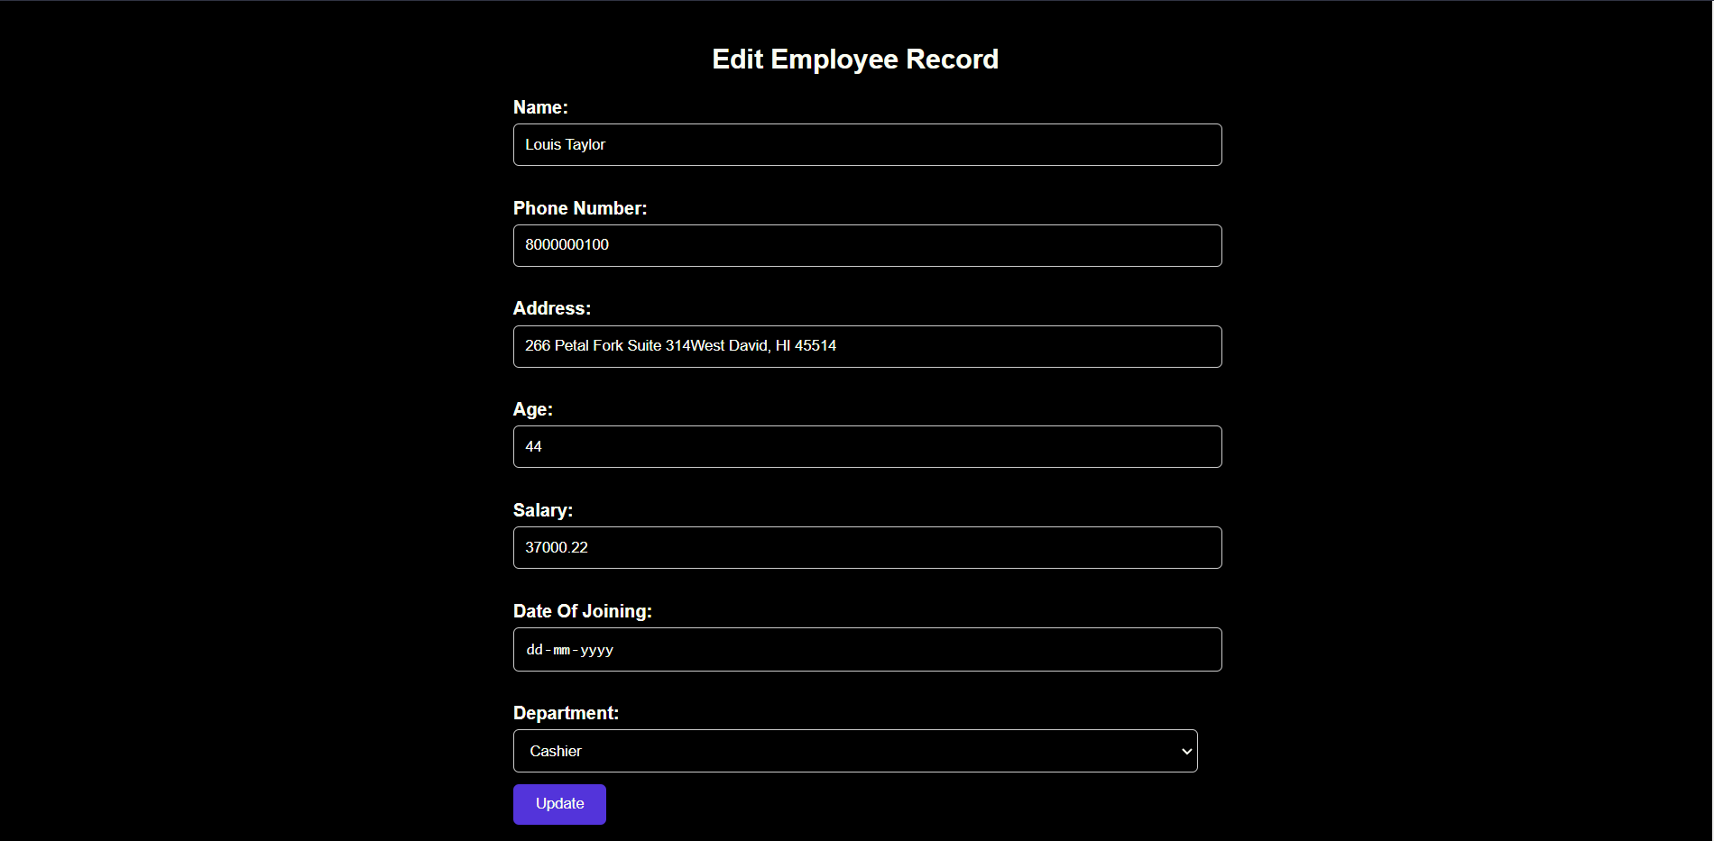
Edit existing records

Slide 12
CONCLUSION
The Supermarket Database Management System is poised to revolutionize the way supermarkets operate, providing a more efficient, accurate, and user-friendly solution for managing various aspects of supermarket management. This transition to a computer-based system will result in enhanced productivity, reduced errors, and improved customer service, ultimately benefiting both the supermarket and its customers.

Slide 13

Thank you very much!

